Slide 1

Horizontal Gel Electrophoresis
MOLECULAR GENETICS LABORATORY BT344 Experiment (3)

Slide 2
Agarose gel electrophoresis is a method to separate DNA, or RNA molecules by size.
This is achieved by moving negatively charged nucleic acid molecules through an agarose matrix with an electric field (electrophoresis).
Shorter molecules move faster and migrate farther than longer ones .

Slide 3
Electrophoresis is the movement of molecules by an electric current.
Nucleic acid moves from a negative to a positive pole.

Slide 4
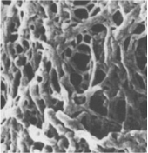
• DNA is negatively charged.
• When placed in an electrical field, DNA will migrate toward the positive
pole (anode).
DNA→
-
+
Power
• Polymerized agarose is porous,
allowing for the movement of DNA
→

Slide 5
How fast will the DNA migrate?
DNA
small
large
-
+
Power

Slide 6
Components of an Electrophoresis System
Power supply and chamber, a source of negatively charged particles with a cathode and anode
Buffer, a fluid mixture of water and ions
Agarose gel, a porous material that DNA migrates through
Gel casting materials
DNA ladder, mixture of DNA fragments of known lengths
Loading dye, contains a dense material and allows visualization of DNA migration
DNA Stain, allows visualizations of DNA fragments after electrophoresis

Slide 7
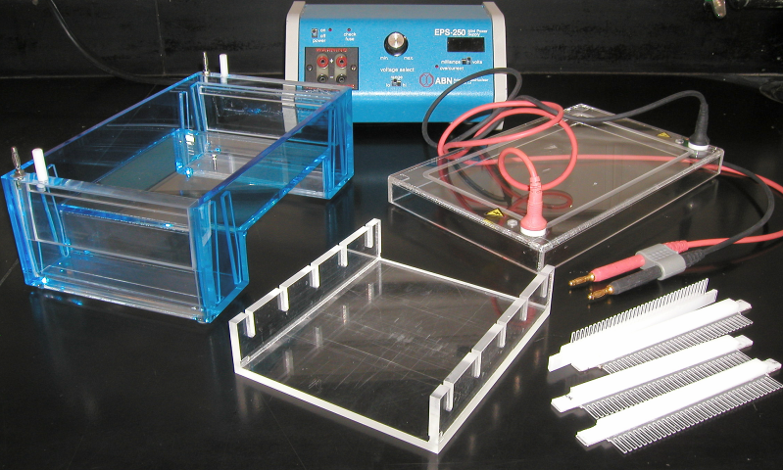
Electrophoresis Equipment
Power supply→
Gel tank→
Cover
Electrical wire
↓
Casting tray
Gel combs

Slide 8
Agarose Gel
A porous material derived from red seaweed
Acts as a sieve for separating DNA fragments; smaller fragments travel faster than large fragments
Concentration affects DNA migration
Low conc. = larger pores→ better resolution of larger DNA fragments
1% agarose
2% agarose
High conc. = smaller pores → better resolution of smaller DNA fragments

Slide 9
Concentrations of used agarose
% Agarose (w/v) | Size Range (kb pairs)for Optimal Separation
0.5 | 2-30
0.75 | 0.7-20
1 | 0.5-10
1.5 | 0.2-3
2 | 0.1-2
3 | 0.07-1.5
4 | 0.04-0.9
5 | 0.03-0.6
6 | 0.01-0.4

Slide 10
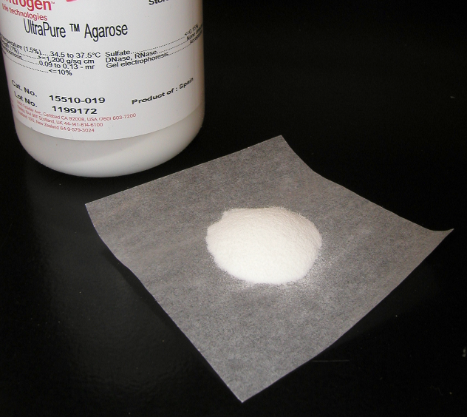

Agarose
3,6-anhydro
L-galactose
D-galactose
Agarose is extracted from seaweed.

Slide 11
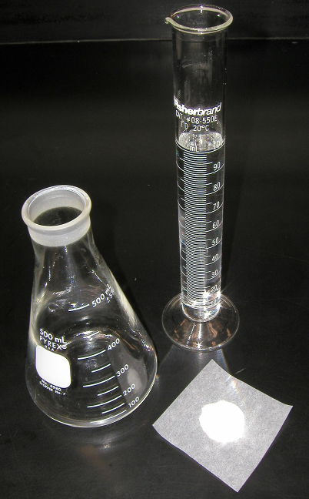
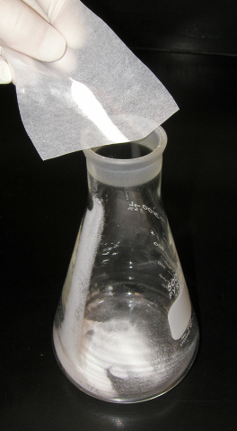
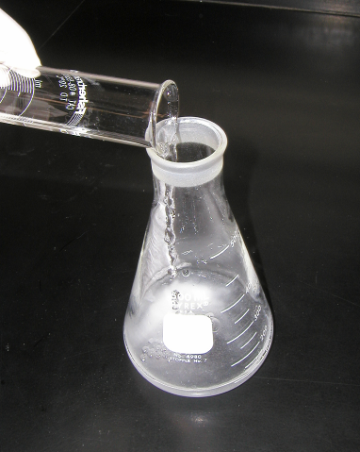
Agarose
Buffer Solution
Combine the agarose powder and buffer solution. Use a flask that is several times larger than the volume of buffer.

Slide 12
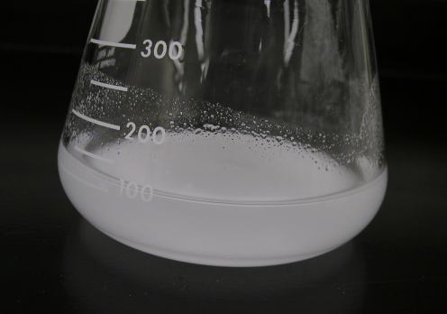
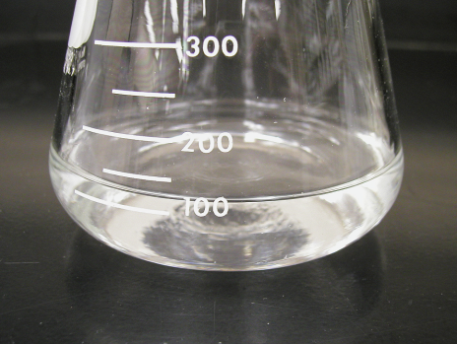
Melting the Agarose
Agarose is insoluble at room temperature (left).
The agarose solution is boiled until clear (right).

Slide 13
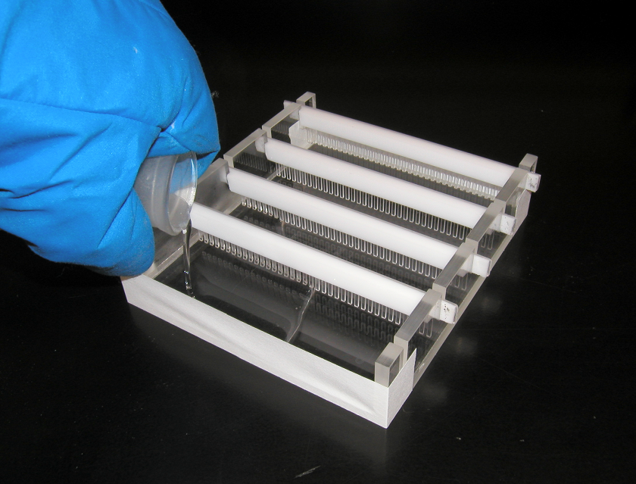
Pouring the gel

Slide 14
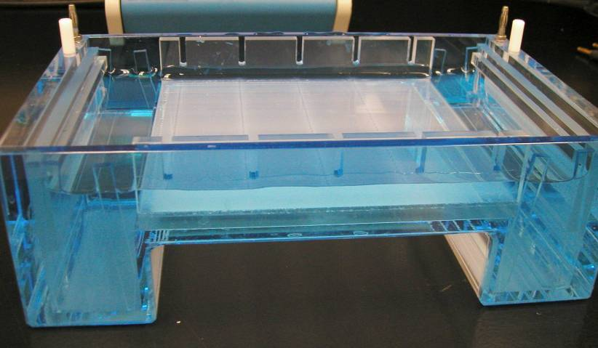
DNA➔
buffer ➔
↑
wells
↑
↑
↑
Anode
(positive)
Cathode
(negative)

Slide 15
Electrophoresis Buffer
TAE (Tris-acetate-EDTA) and TBE (Tris-borate-EDTA) are the most common buffers for duplex DNA
Establish pH and provide ions to support conductivity
Concentration affects DNA migration
Use of water will produce no migraton
High buffer conc. could melt the agarose gel
Notes:
A buffer is a chemical system that maintains a relatively constant pH even when strong acids or bases are added. Buffer solutions contain either a weak acid or weak base and one of their salts. Because a change in pH can alter the charge on a particle, it is important to use a buffer solution when separating during electrophoresis.

Slide 16
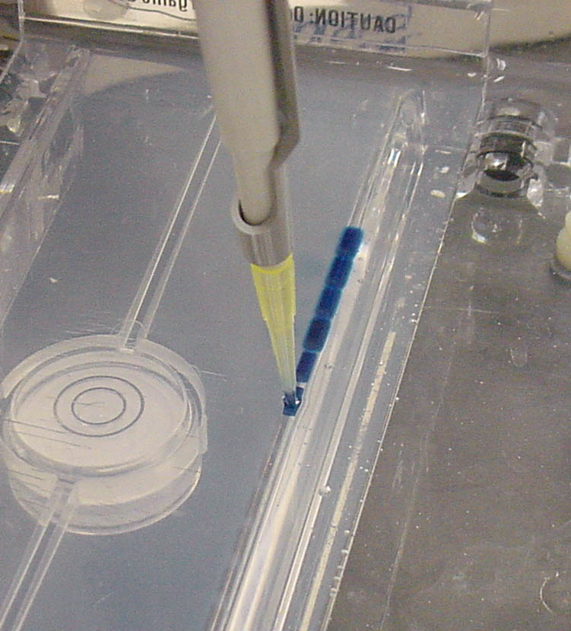
Loading Dye
DNA samples are loaded into a gel AFTER the tank has been filled with buffer, covering the gel
Contains a dense substance, such as glycerol, to allow the sample to "fall" into the sample wells
Contains one or two tracking dyes, which migrate in the gel and allow monitoring of how far the electrophoresis has proceeded.

Slide 17
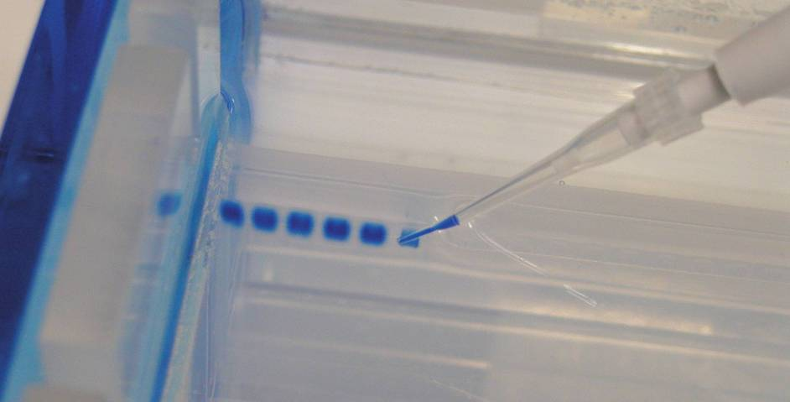
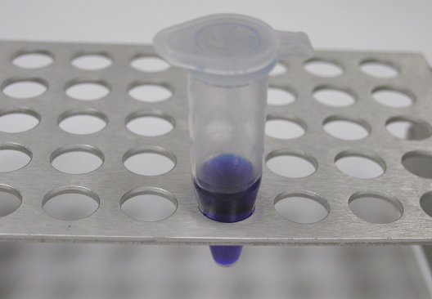
Loading the Gel
Sample Preparation
Carefully place the pipette tip over a well and gently expel the sample. The sample should sink into the well. Be careful not to puncture the gel with the pipette tip.
Loading dye: →
Bromophenol Blue (for color)

Slide 18
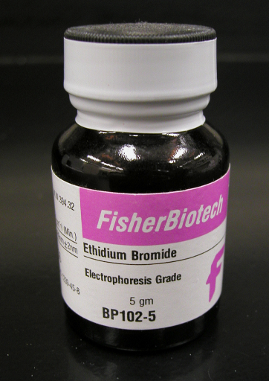
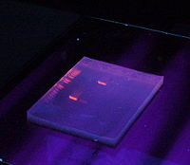
Staining DNA in the Gel
• Allows DNA visualization after gel electrophoresis
Ethidium bromide binds to DNA and fluoresces under UV light, allowing the visualization of DNA on a Gel.
***CAUTION! Ethidium bromide is a powerful mutagen and is moderately toxic. Gloves should be always worn.

Slide 19
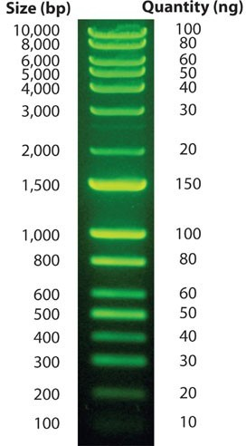
DNA ladder
It is a solution of DNA molecules of different length
DNA Ladder consists of known DNA sizes used to determine the size of an unknown DNA sample.
The DNA ladder usually contains regularly spaced sized samples which when run on an agarose gel looks like a "ladder".

Slide 20
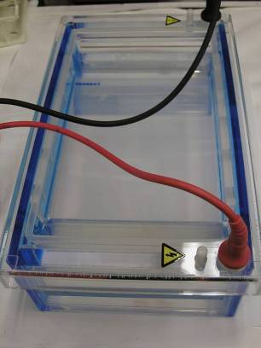
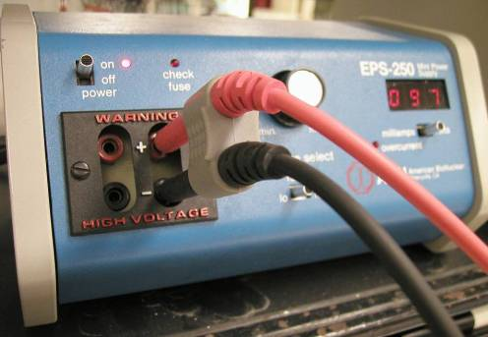
Running the Gel

Slide 21
Analysis
After electrophoresis, the gel is illuminated with an ultraviolet lamp to view the DNA bands. The ethidium bromide fluoresces reddish-orange in the presence of DNA.
photograph it with a digital camera.

Slide 22
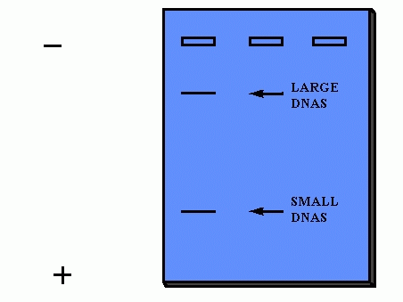
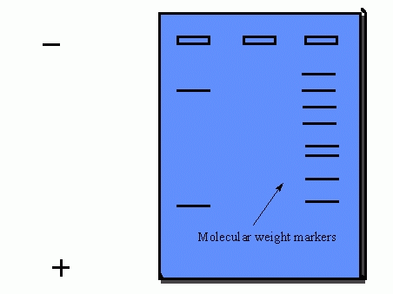

Slide 23
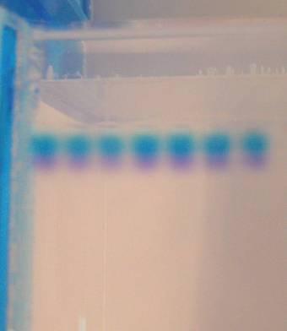
Cathode
(-)
DNA
(-)
↓
← wells
← Bromophenol Blue
Gel
Anode
(+)

Slide 24
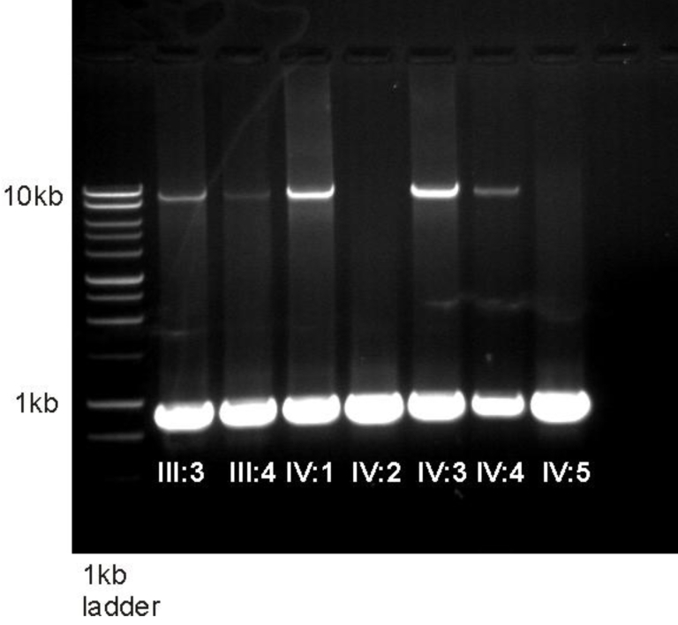

Slide 25
Applications
Estimation of the size of DNA molecules following restriction enzyme digestion, e.g. in restriction mapping of cloned DNA.
Analysis of PCR products, e.g. in molecular genetic diagnosis or genetic fingerprinting
Separation of DNA fragments for extraction and purification.
Separation of restricted genomic DNA prior to Southern transfer, or of RNA prior to Northern transfer.

Slide 26
Protocol
Prepare gel tray and place comb in gel tray.
Prepare a 1 % agarose solution, measure 1.0 g agarose into a flask and add 100 ml 1X TBE buffer. Microwave until agarose is dissolved and solution is clear.
Allow solution to cool to about 60°C before pouring. Add 1 µl of Ethidium bromide.
Pour 60°C gel solution into tray and allow gel to solidify about 30 minutes at room temperature.
To run, gently remove the comb, place tray in electrophoresis chamber, and cover (just until wells are submerged) with electrophoresis buffer (the same buffer used to prepare the agarose).
To prepare samples for electrophoresis, add 2 μl of 6x gel loading dye for every 5 μl of DNA solution. Mix well & load. Don’t forget to load the DNA size marker.
Electrophoresis at 50-150 volts until dye markers have migrated an appropriate distance, depending on the size of DNA to be visualized.
Visualize DNA under the UV transilluminator.

